Slide 1
EE281 (Introduction to Electrical Engineering II) and EE285 (Electronics I) BJT Transistor Biasing
Dr. Melaka Senadeera
Department of Electrical and Electronics Engineering
University of Peradeniya
Peradeniya

Slide 2
Introduction – Biasing
The analysis or design of a transistor amplifier requires knowledge of both the dc and ac response of the system. In fact, the amplifier increases the strength of a weak signal by transferring the energy from the applied DC source to the weak input ac signal The analysis or design of any electronic amplifier therefore has two components:
•The dc portion and
•The ac portion
During the design stage, the choice of parameters for the required dc levels will affect the ac response.
What is biasing circuit?
Biasing: Application of dc voltages to establish a fixed level of current and voltage.

Slide 3
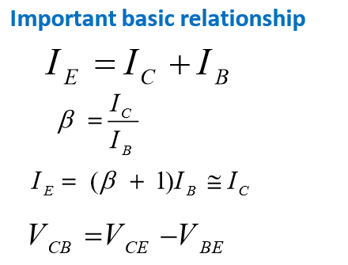
Purpose of the DC biasing circuit
To turn device “ON”
To place it in operation in the region of its
characteristic where the device operates most
linearly
Proper biasing circuit which operates in the linear
region and circuit have centered Q-point and
midpoint biased
Improper biasing cause improper biasing
scheme
Distortion in the output signal
Produce limited or clipped at output
signal

Slide 4
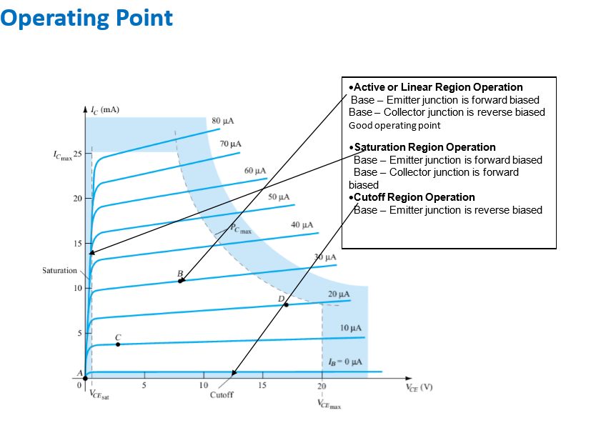

Slide 5
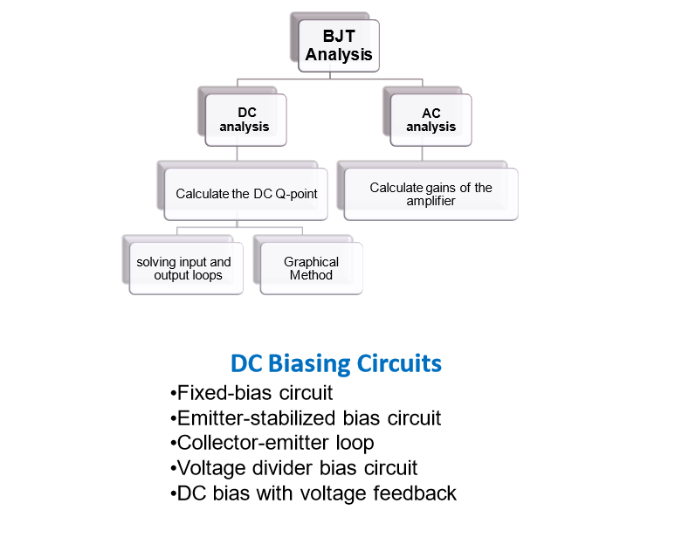

Slide 6
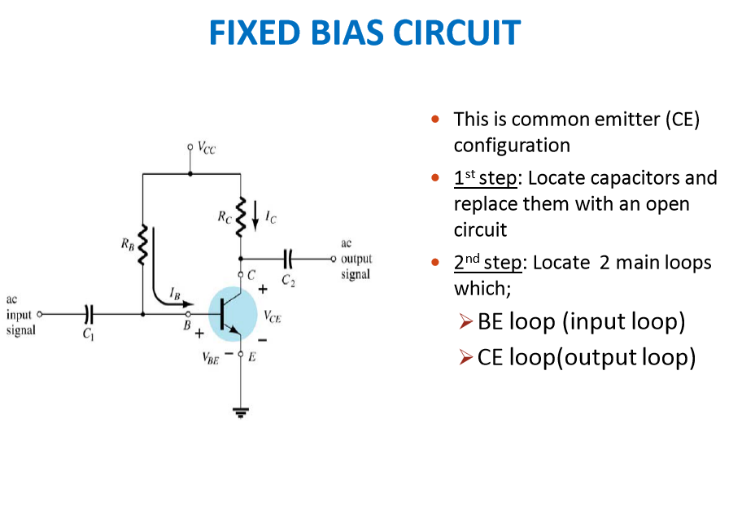
Notes:
666

Slide 7
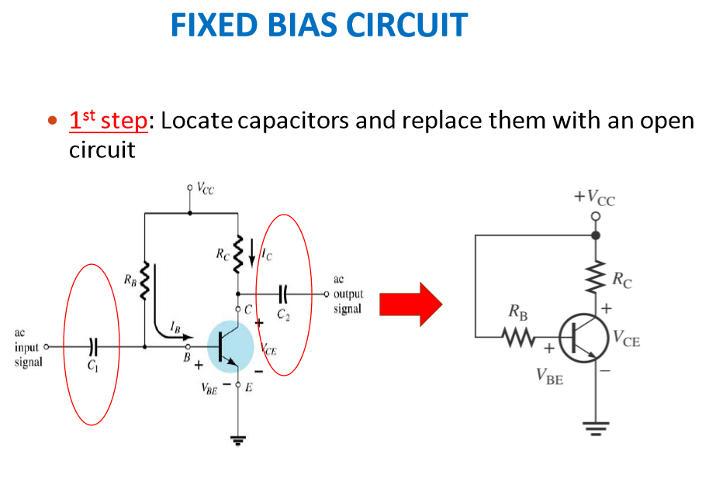
Notes:
777

Slide 8
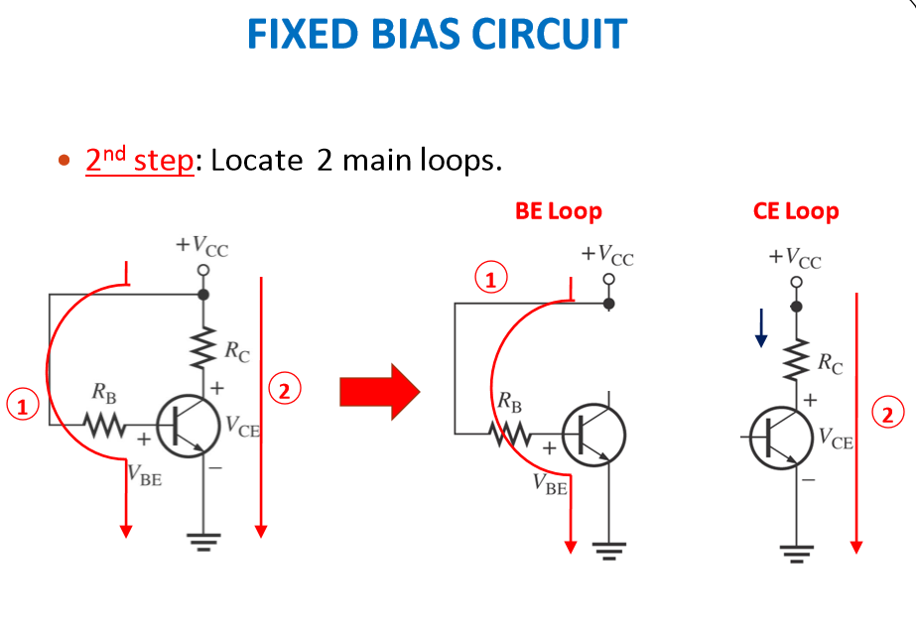
Notes:
888

Slide 9
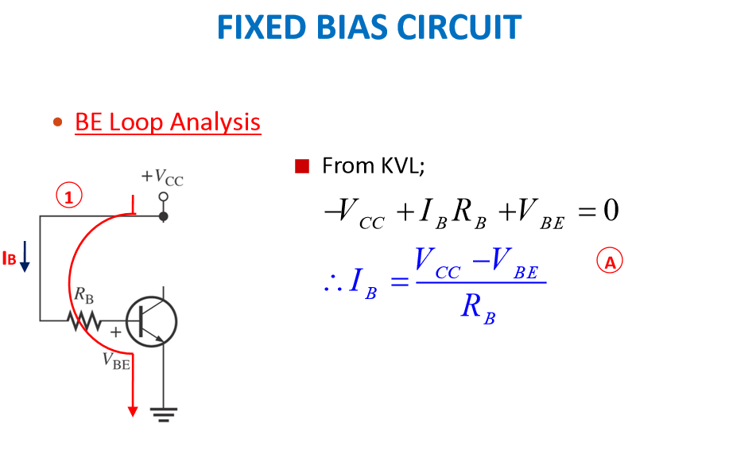
Notes:
999

Slide 10
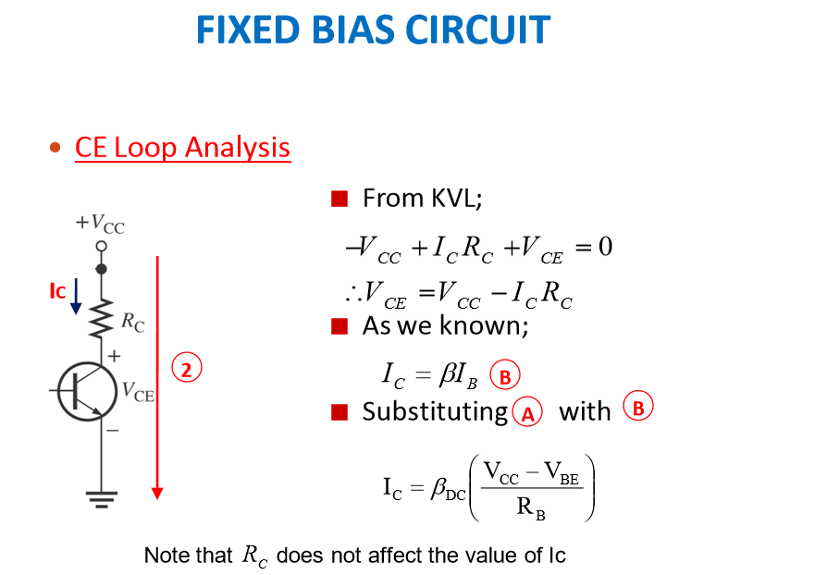
Notes:
101010

Slide 11
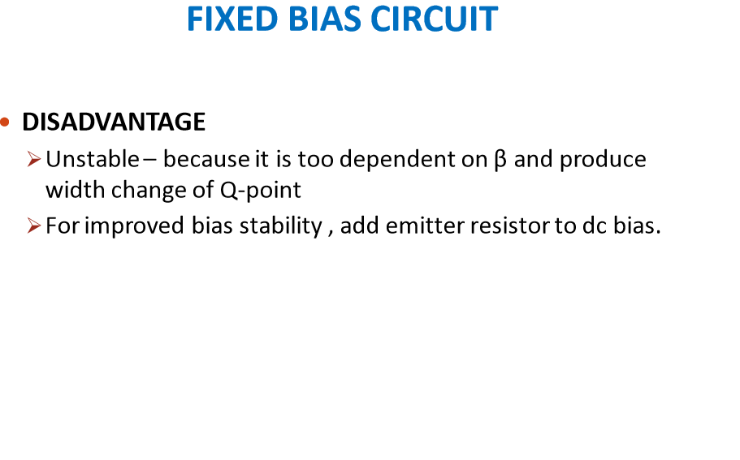
Notes:
111111

Slide 12
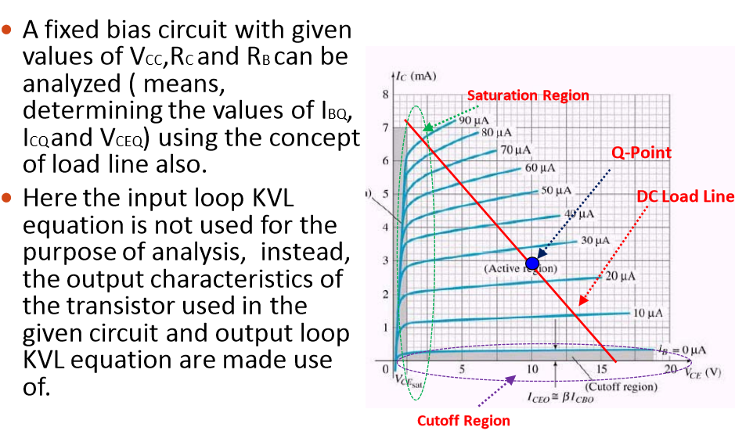
Load line Analysis
Notes:
121212

Slide 13
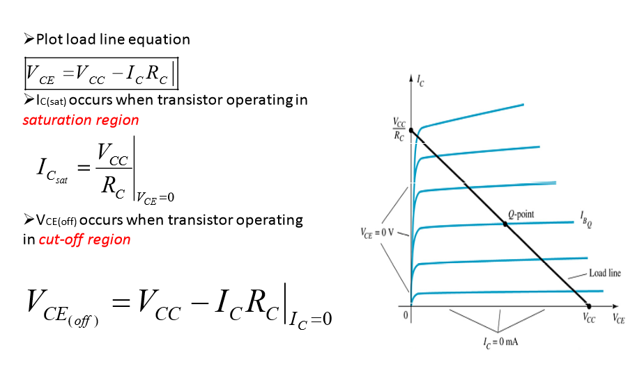
Notes:
131313

Slide 14
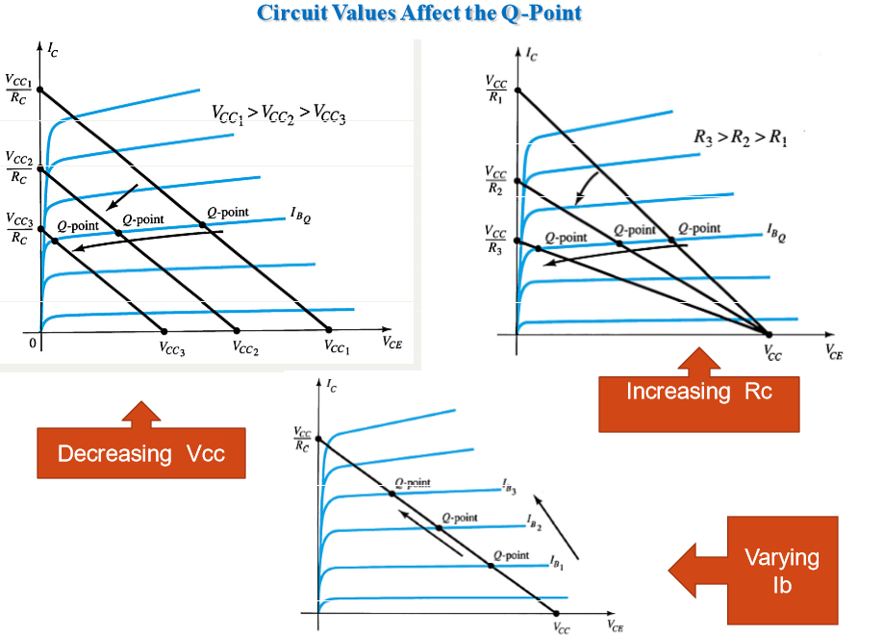
Notes:
141414

Slide 15
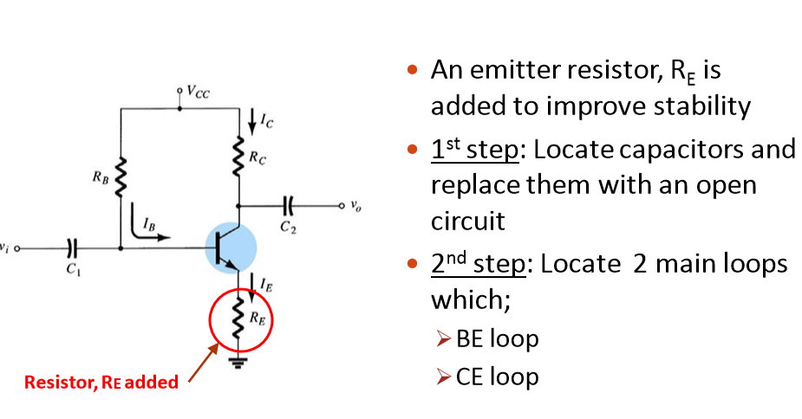
EMITTER-STABILIZED BIAS CIRCUIT
Notes:
151515

Slide 16
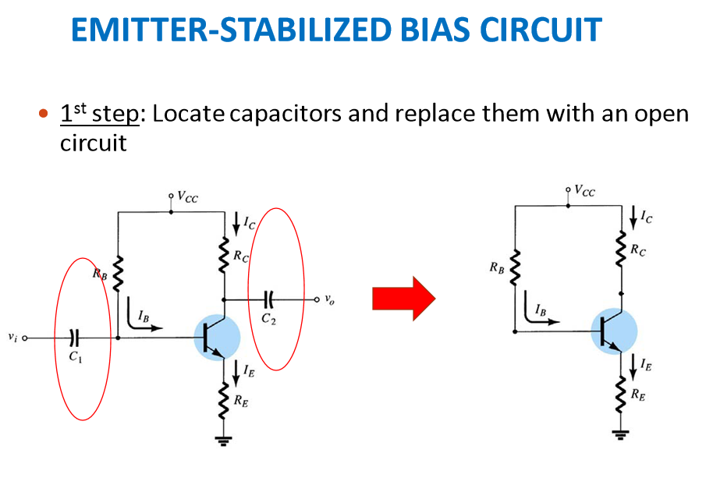
Notes:
161616

Slide 17
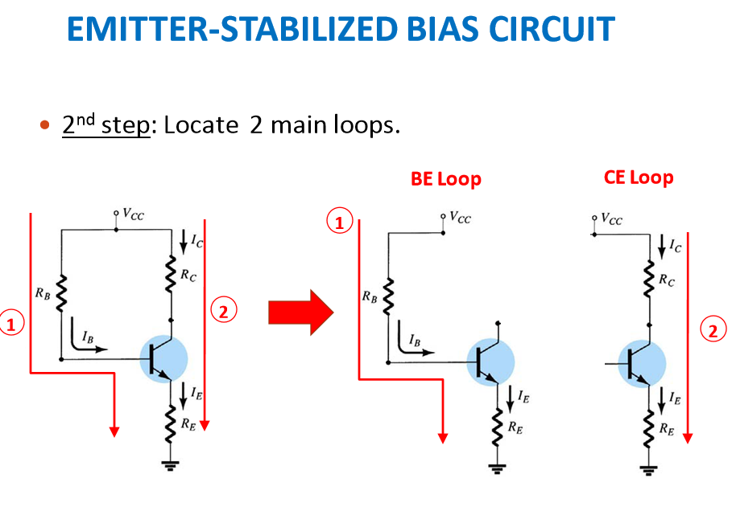
Notes:
171717

Slide 18
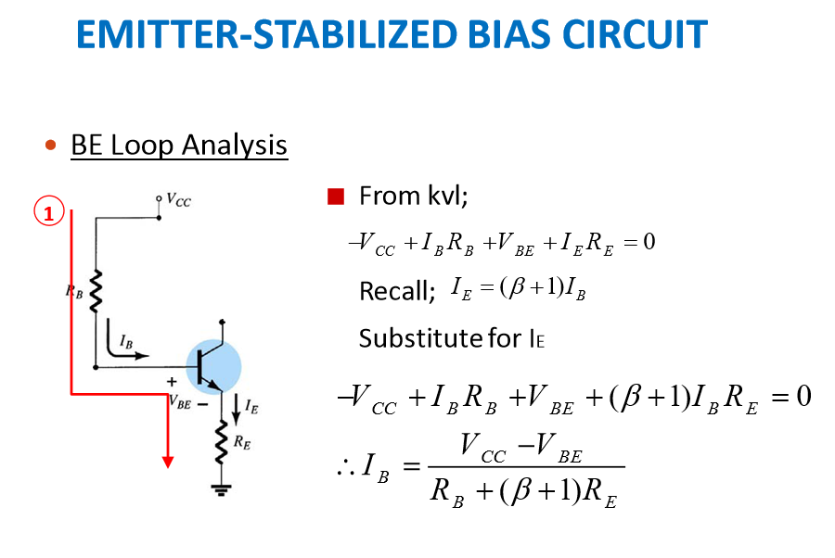
Notes:
181818

Slide 19
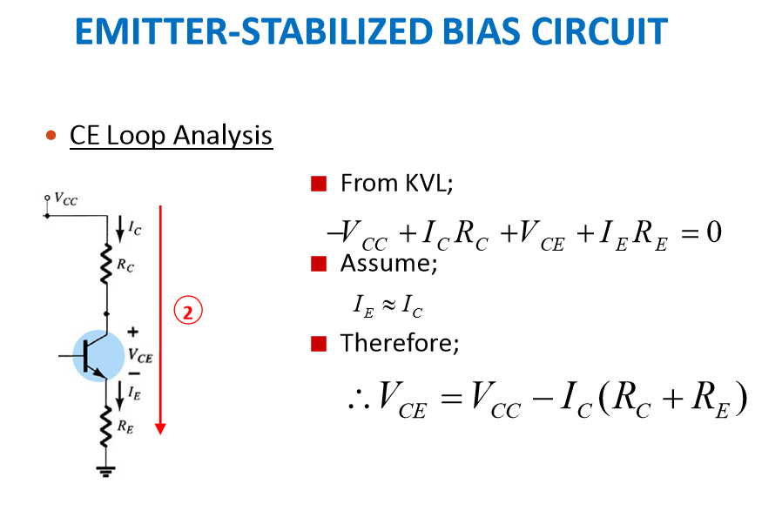
Notes:
191919

Slide 20
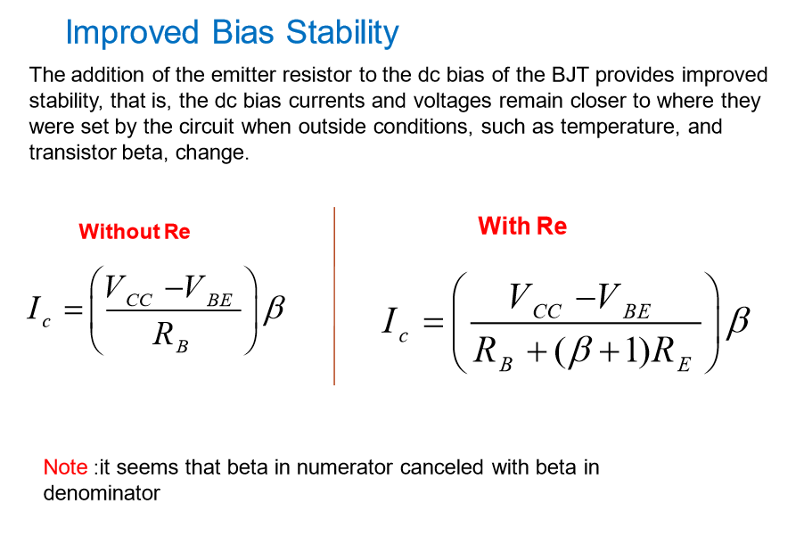
Notes:
202020

Slide 21
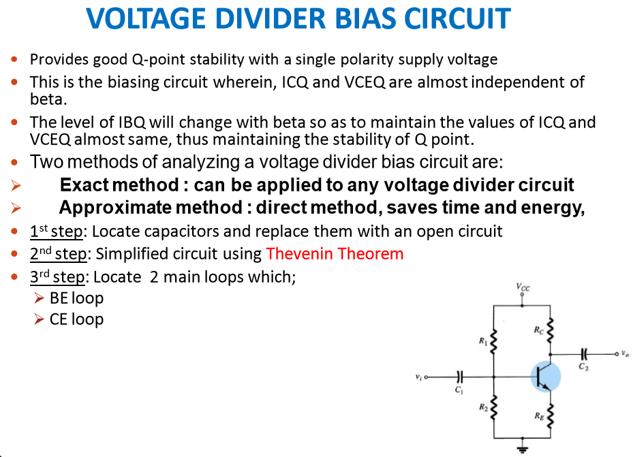
Notes:
212121

Slide 22
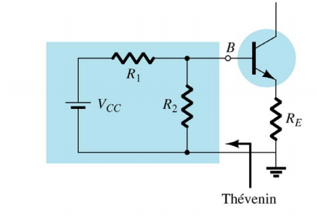
REDRAWING THE INPUT CIRCUIT FOR THE NETWORK
Notes:
222222

Slide 23
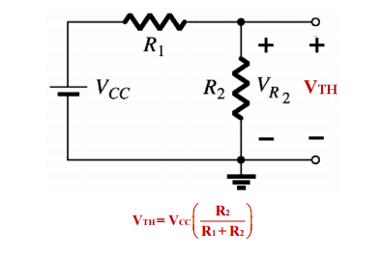
DETERMINING V_{TH}
Notes:
232323

Slide 24
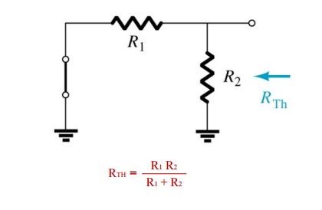
DETERMINING V_{TH}
Notes:
242424

Slide 25
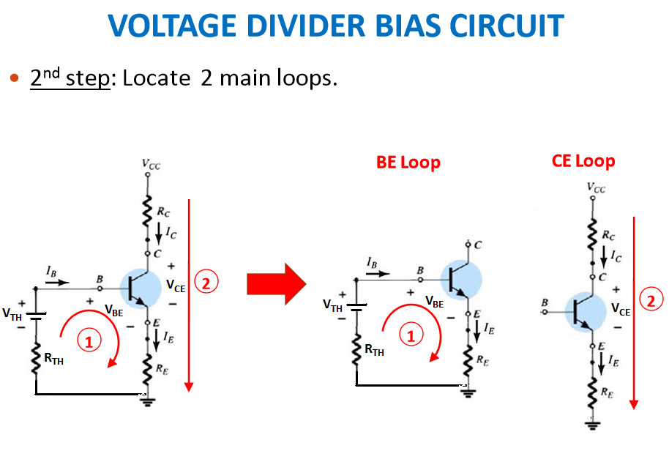
Notes:
252525

Slide 26
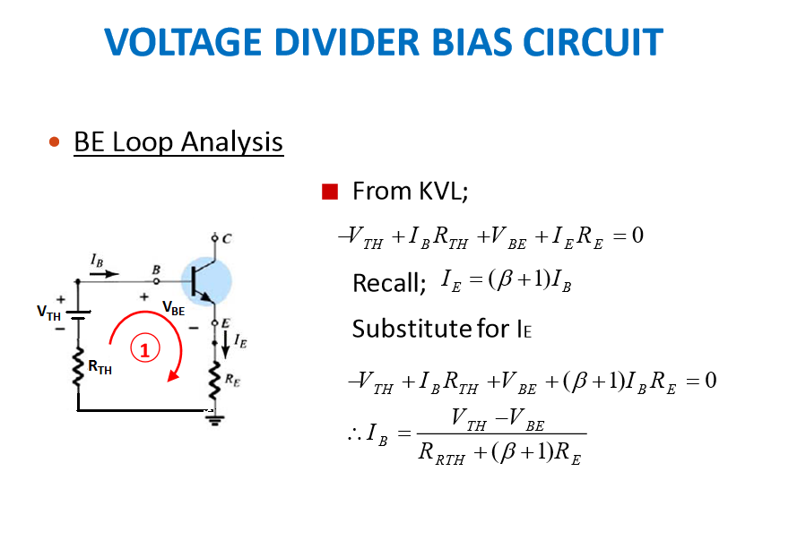
Notes:
262626

Slide 27
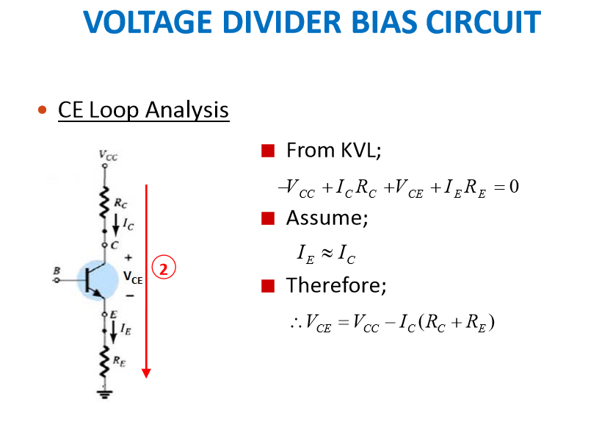
Notes:
272727

Slide 28
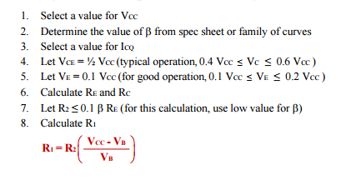
DESIGN OF COMMON-EMIITTER AMPLIFIER WITH VOLTAGE DIVIDER BIAS
Notes:
282828

Slide 29
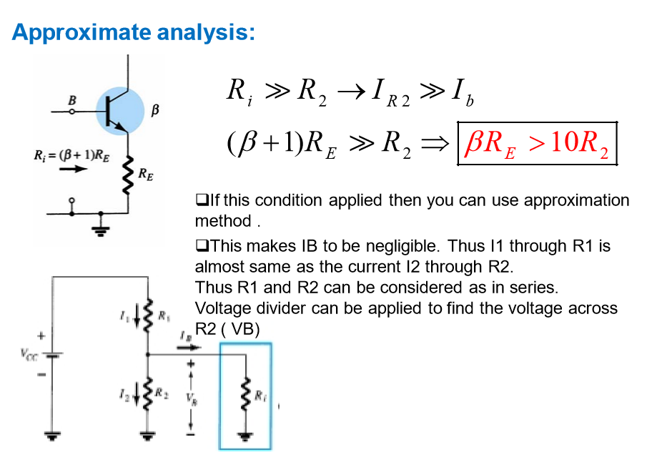
Notes:
292929

Slide 30
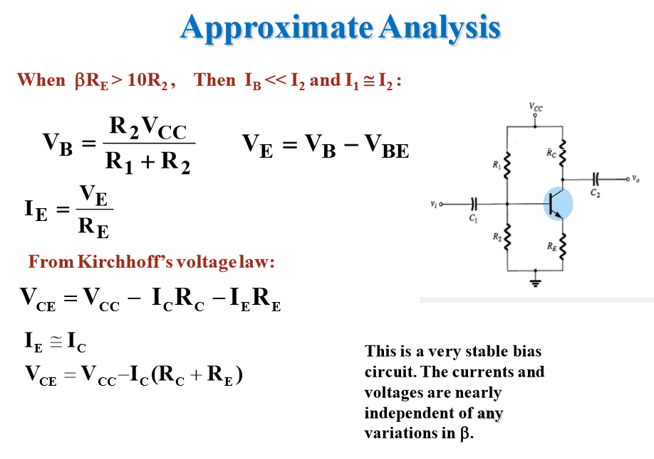
Notes:
303030

Slide 31
Thank you
Notes:
313131

